Slide 1
Java on Azure
@thecodealchemist

Slide 2

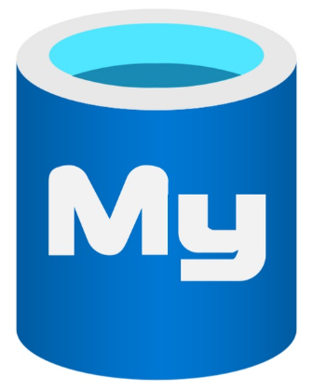


Agenda

Slide 3
Prerequisites
Basic knowledge of Spring Boot
Azure account

Slide 4

Steps
Setup Azure MySql Database
Develop Spring Boot service
DB connectivity

Slide 5

Agenda

Slide 6
Prerequisites
Basic Spring Boot Knowledge
Basic Cloud Knowledge
An Azure Account

Slide 7
Steps
Setup Azure PostGreSQL Database
Develop Spring Boot service
DB connectivity

Slide 8

Agenda
Reading Secrets

Slide 9
Steps
Setup an Azure Key Vault
Create secrets for Azure MySQL and PostGres
Enhance services to read secrets from key vault

Slide 10

Agenda
S
U
B
S
C
R
I
B
E
R
S

Slide 11
Steps
Setup an Azure Event Hub
Trigger events from Spring boot app

Slide 12

Agenda
Azure Cache for Redis

Slide 13
Steps
Setup an Azure Cache for Redis instance
Develop Spring Boot Service
Establish connectivity

